Slide 1


Leslie Luo
22 Feb 2024

Slide 2

Outline
Executive Summary
Introduction
Methodology
Results
Conclusion
Appendix

Slide 3
Executive Summary
Summary of methodologies
Summary of all results

Slide 4
Introduction
Project background and context
Question: Can We Predict the Successful Landing of Falcon 9's First Stage to Estimate Launch Costs and Inform Competitive Bidding Strategies?

Slide 5

Section 1

Slide 6
Methodology
Executive Summary
Data collection methodology:
Use API and web-scrape
Perform data wrangling
Standardise numeric variables and convert categories into dummies
Perform exploratory data analysis (EDA) using visualization and SQL
Perform interactive visual analytics using Folium and Plotly Dash
Perform predictive analysis using classification models
Use best score and confusion matrix to assess the accuracy of the models

Slide 7
Data Collection
How data sets were collected.
Identify Data Sources
SpaceX's website
Aerospace databases
Government and industry reports
Data Extraction
Use of APIs for structured data
Web scraping for unstructured data
Manual collection for non-digital sources
Data Cleaning
Format standardization
Missing value treatment
Outlier detection and handling
Feature Selection
Based on literature review
Expert consultations
Preliminary data analysis
Data Integration
Merging datasets
Ensuring data consistency
Data Ready for Analysis
Start
End

Slide 8
Data Collection – SpaceX API
The GitHub URL of the completed SpaceX API calls notebook
Identify Relevant API Endpoints
Execute API Calls
Parse JSON Responses
Filter, Structure, Validate Data
Configure API Requests

Slide 9
Data Collection - Scraping
The GitHub URL of the completed web scraping notebook
Identify Data Source
Write Scraping Script & Test Script
Run Scraping Process
Analyze Website Structure & Choose Scraping Tools
Data Cleaning, Formatting & Validating

Slide 10
Data Wrangling
The GitHub URL of completed data wrangling related notebooks
Initial Data Assessment
Data Transformation (Normalize, Aggregate, De-duplicate)
Data Integration, Feature Engineering
Data Cleaning (Missing, Errors, Formats)
Data Reduction

Slide 11
EDA with Data Visualization
The GitHub URL of completed EDA with data visualization notebook
Chart Summaries & Purposes
Scatterplots:
Flight Number vs. Launch Site: Identifies launch distribution over time and by site.
Payload vs. Launch Site & Orbit Type: Shows payload preferences for sites and orbits.
Flight Number vs. Orbit Type: Reveals mission focus changes over time.
Barchart:
Success Rate by Orbit Type: Compares success rates across orbits, highlighting reliability.
Line Chart:
Yearly Launch Success Trend: Traces success trends over years, indicating performance changes.
Why These Charts?
Scatterplots: Best for visualizing relationships between two variables, highlighting patterns or clusters.
Barchart: Ideal for categorical comparison, showing differences in success rates by orbit.
Line Chart: Effective for trend analysis over time, revealing changes in launch success.

Slide 12
EDA with SQL
The GitHub URL of completed EDA with SQL notebook
SQL queries summary
Table Creation:
Created SPACEXTABLE from SPACEXTBL where dates exist.
Launch Site Analysis:
Queried first 5 launches from 'CCA' sites.
Payload Analysis:
Total mass for NASA (CRS).
Average mass for 'F9 v1.1' booster.
Landing Outcome Insights:
Earliest successful ground pad landing.
Booster versions for successful drone ship landings with payloads between 4000-6000kg.
Landing Success & Failures:
Counted successes and failures overall.
Specifically counted successes and failures.
Heaviest Payload Booster:
Identified booster for the maximum payload mass.
2015 Drone Ship Failures:
Details of failures including month, booster, and site.
Landing Outcome Trends (2010-2017):
Grouped and ordered landing outcomes by count.

Slide 13
Build an Interactive Map with Folium
The GitHub URL of completed interactive map with Folium map
Summarize map objects & Why added those objects
Marker: Marks specific locations with customizable icons.
Circle: Draws circles with defined radii to highlight areas.
Mouse Position: Shows real-time latitude and longitude under the mouse cursor.
Distance Marker: Marks distances along paths or lines.
Lines: Connects multiple points with lines to depict routes or boundaries.

Slide 14
Build a Dashboard with Plotly Dash
The GitHub URL of completed Plotly Dash lab
Summarize plots/graphs and interactions & Why
Success Pie Chart with Site Dropdown
Visualizes launch success rates by site.
Enables comparison and performance assessment.
Payload Range Slider
Allows filtering of launches by payload weight.
Facilitates tailored analysis on selected payload ranges.
Success-Payload Scatter Chart
Plots relationship between payload weight and launch success.
Identifies trends, supporting data-driven insights.

Slide 15
Predictive Analysis (Classification)
The GitHub URL of completed predictive analysis lab
Data Preprocessing
Hyperparameter Tuning
Performance Evaluation
Model Training
Model Optimization, Best Model Identification

Slide 16
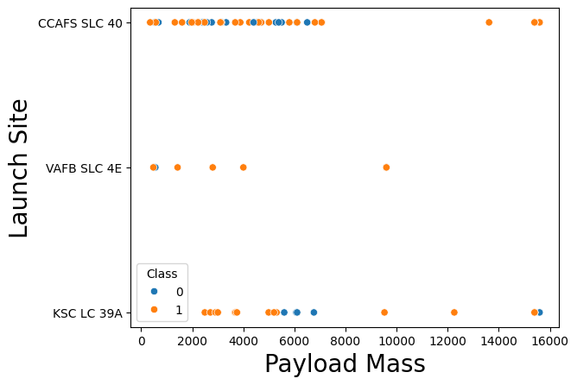
Results
Exploratory data analysis results

Slide 17
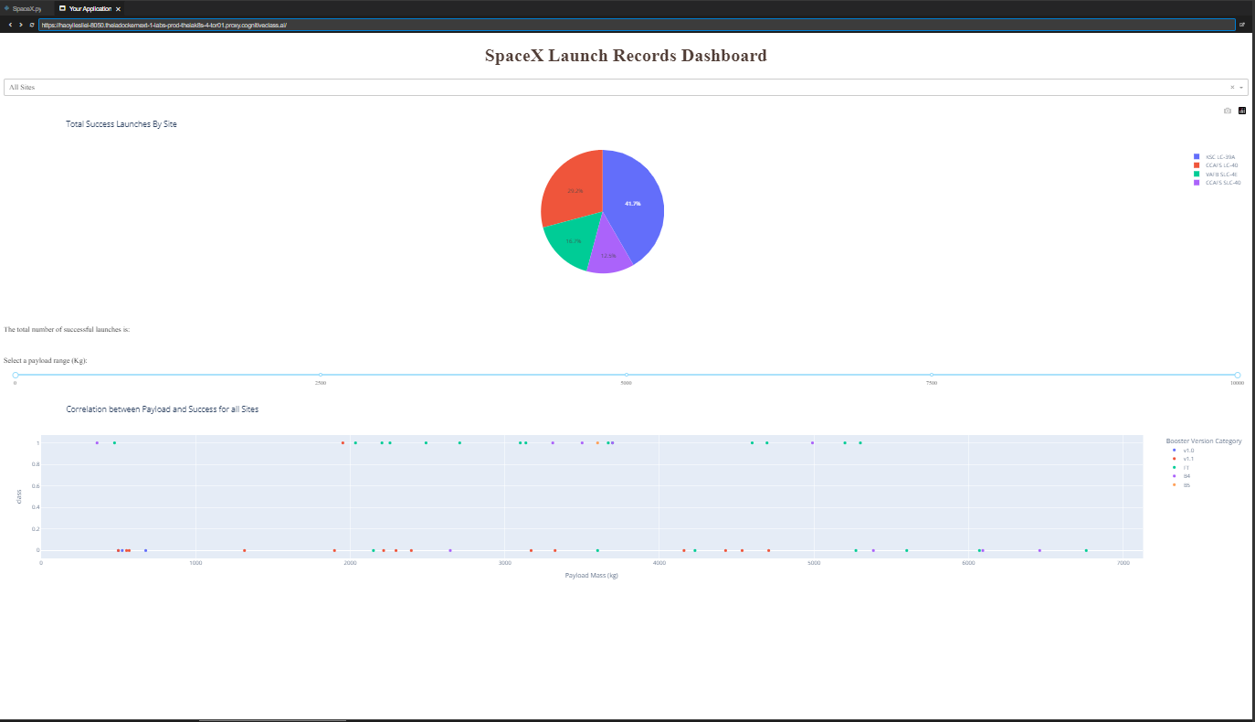
Results
Interactive analytics demo in screenshots

Slide 18
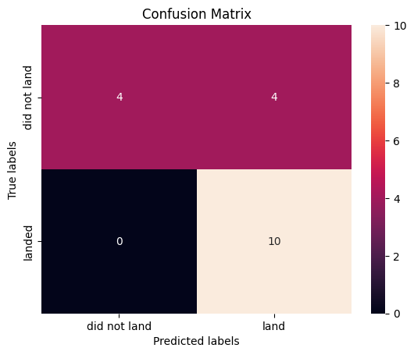
Results
Predictive analysis results

Slide 19

Section 2

Slide 20
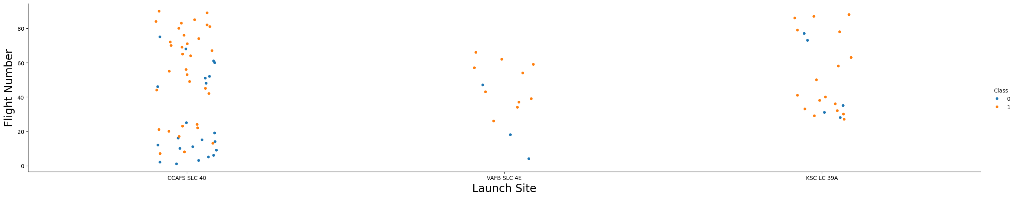
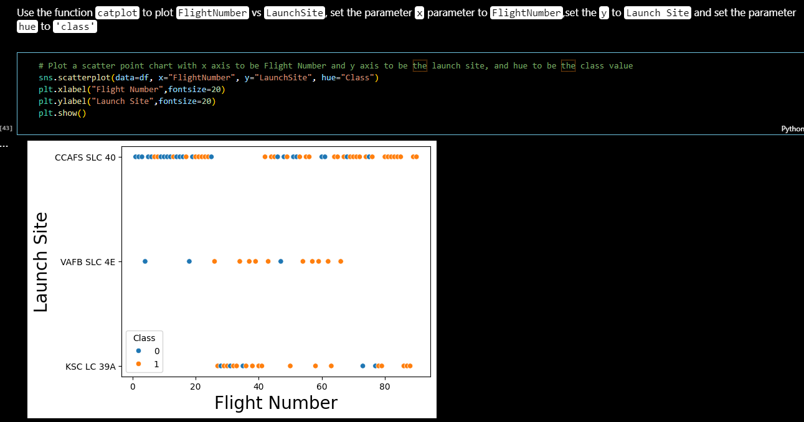
Flight Number vs. Launch Site
Show a scatter plot of Flight Number vs. Launch Site
Show the screenshot of the scatter plot with explanations

Slide 21
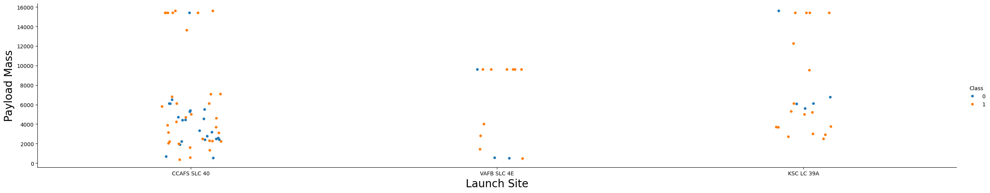
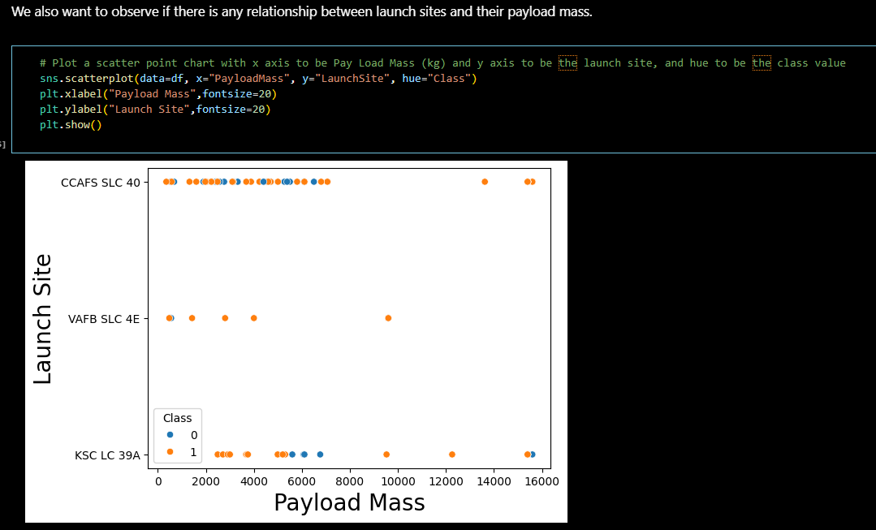
Payload vs. Launch Site
Show a scatter plot of Payload vs. Launch Site
Show the screenshot of the scatter plot with explanations

Slide 22
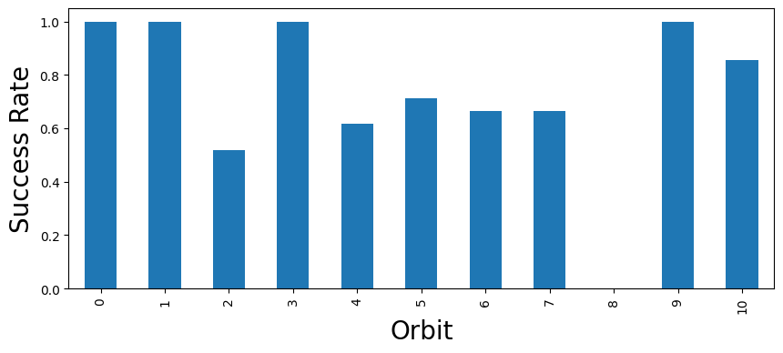
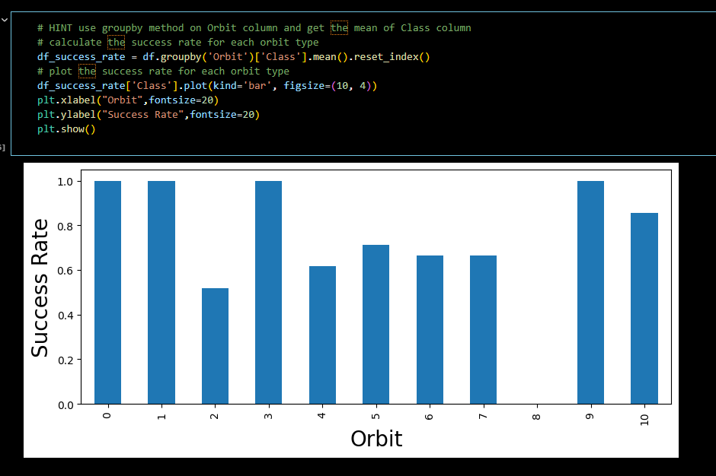
Success Rate vs. Orbit Type
Show a bar chart for the success rate of each orbit type
Show the screenshot of the scatter plot with explanations

Slide 23
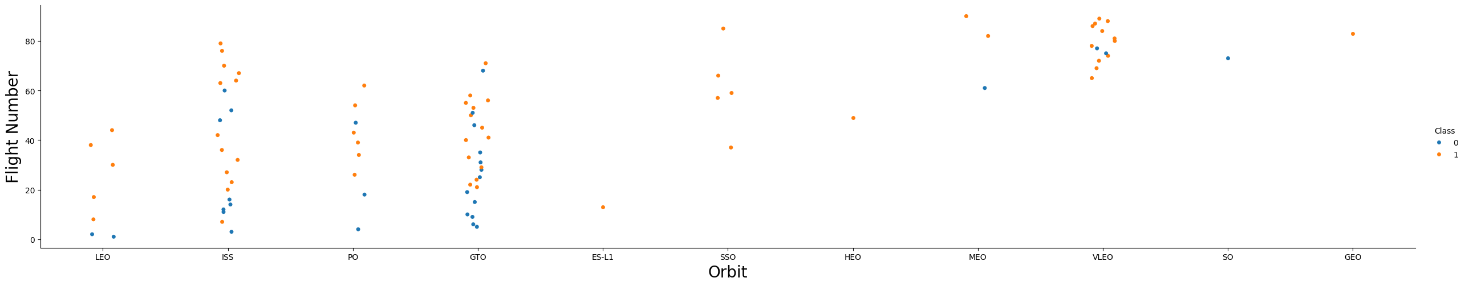
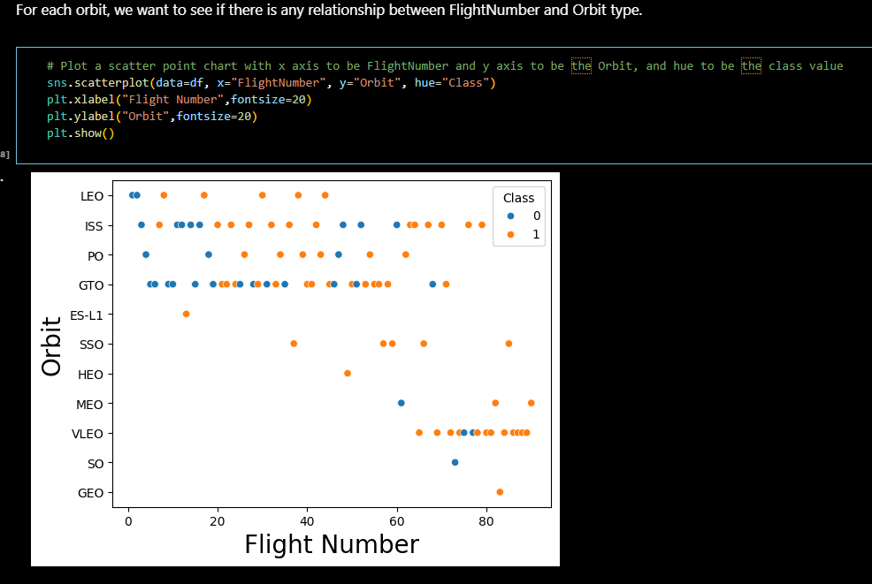
Flight Number vs. Orbit Type
Show a scatter point of Flight number vs. Orbit type
Show the screenshot of the scatter plot with explanations

Slide 24
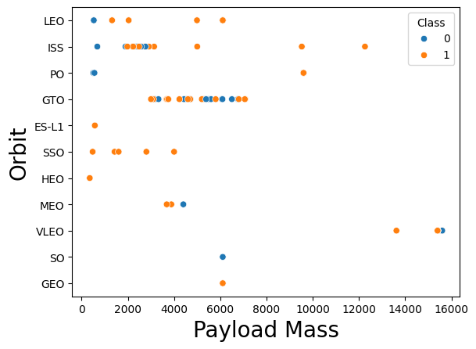
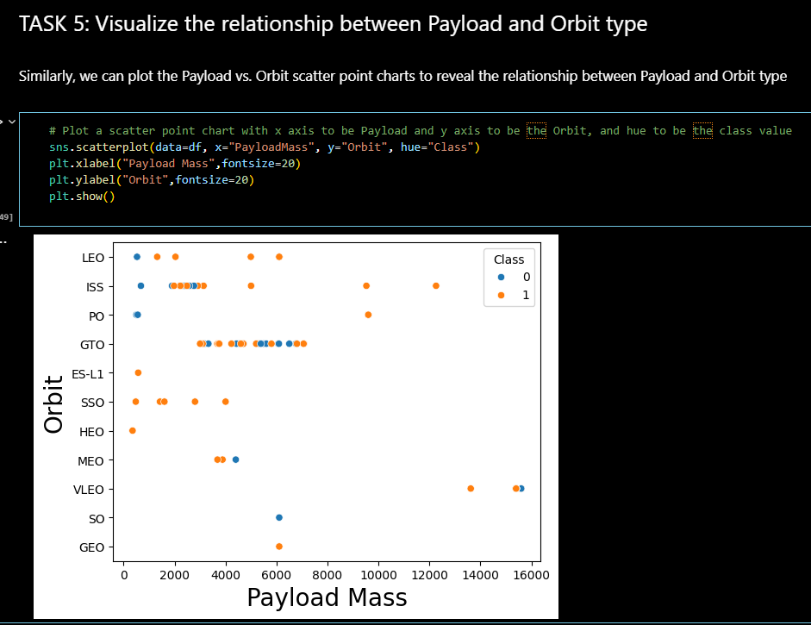
Payload vs. Orbit Type
Show a scatter point of payload vs. orbit type
Show the screenshot of the scatter plot with explanations

Slide 25
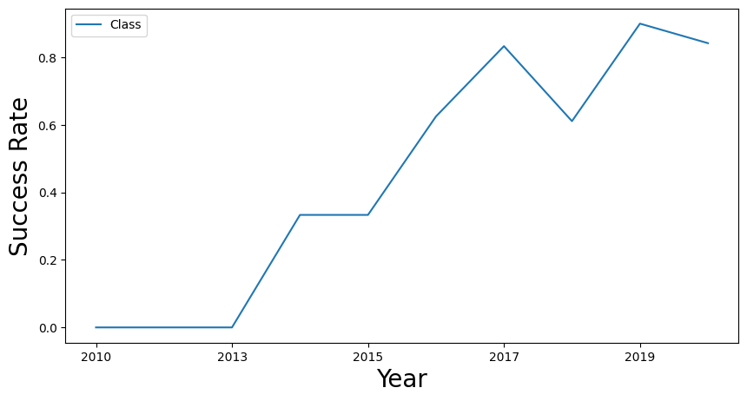
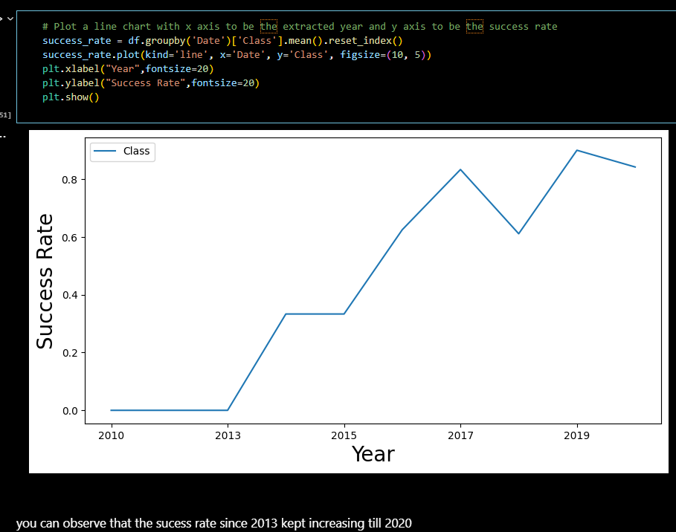
Launch Success Yearly Trend
Show a line chart of yearly average success rate
Show the screenshot of the scatter plot with explanations

Slide 26
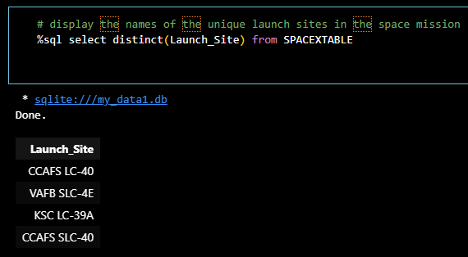
All Launch Site Names
Find the names of the unique launch sites
the query below shows the unique launch sites in the space mission

Slide 27
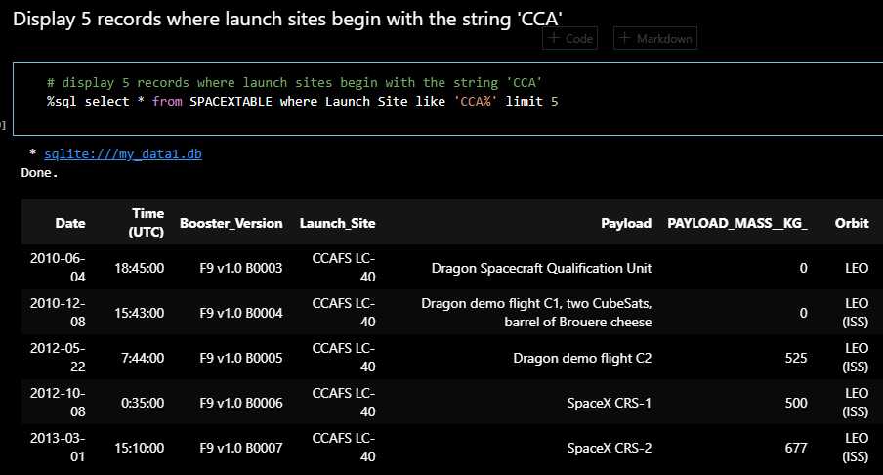
Launch Site Names Begin with 'CCA'
Find 5 records where launch sites begin with `CCA`

Slide 28
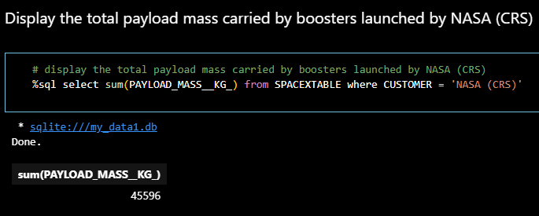
Total Payload Mass
Calculate the total payload carried by boosters from NASA

Slide 29
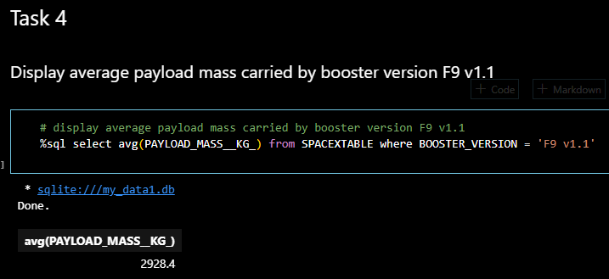
Average Payload Mass by F9 v1.1
Calculate the average payload mass carried by booster version F9 v1.1

Slide 30
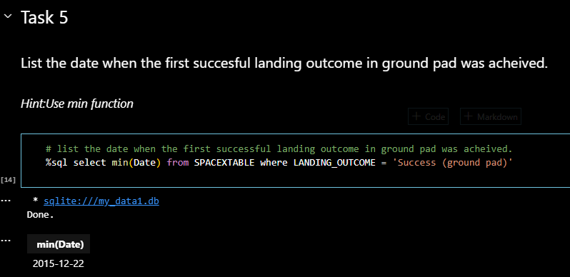
First Successful Ground Landing Date
Find the dates of the first successful landing outcome on ground pad

Slide 31
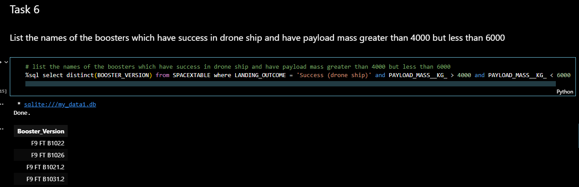
Successful Drone Ship Landing with Payload between 4000 and 6000
List the names of boosters which have successfully landed on drone ship and had payload mass greater than 4000 but less than 6000

Slide 32
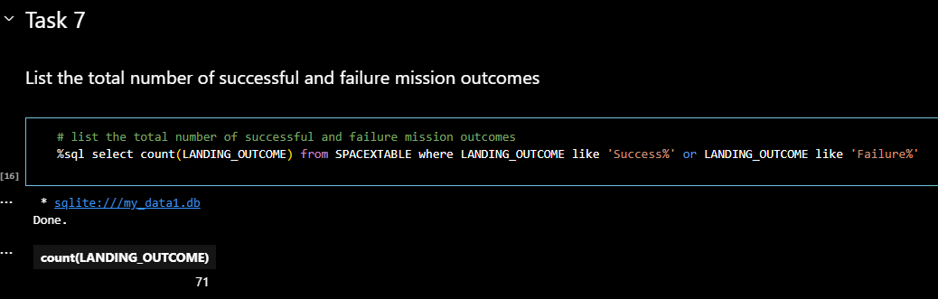
Total Number of Successful and Failure Mission Outcomes
Calculate the total number of successful and failure mission outcomes

Slide 33
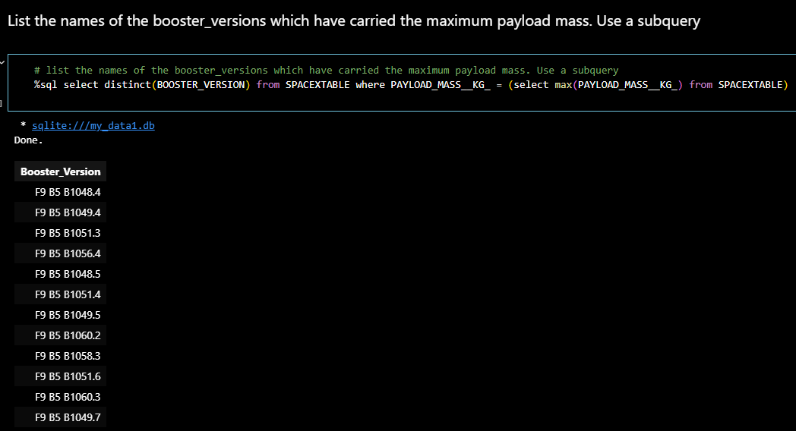
Boosters Carried Maximum Payload
List the names of the booster which have carried the maximum payload mass

Slide 34
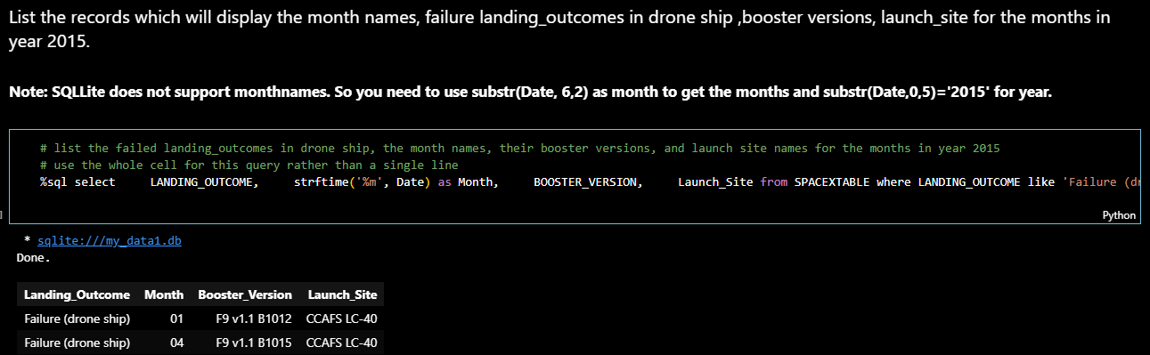
2015 Launch Records
List the failed landing_outcomes in drone ship, their booster versions, and launch site names for in year 2015

Slide 35
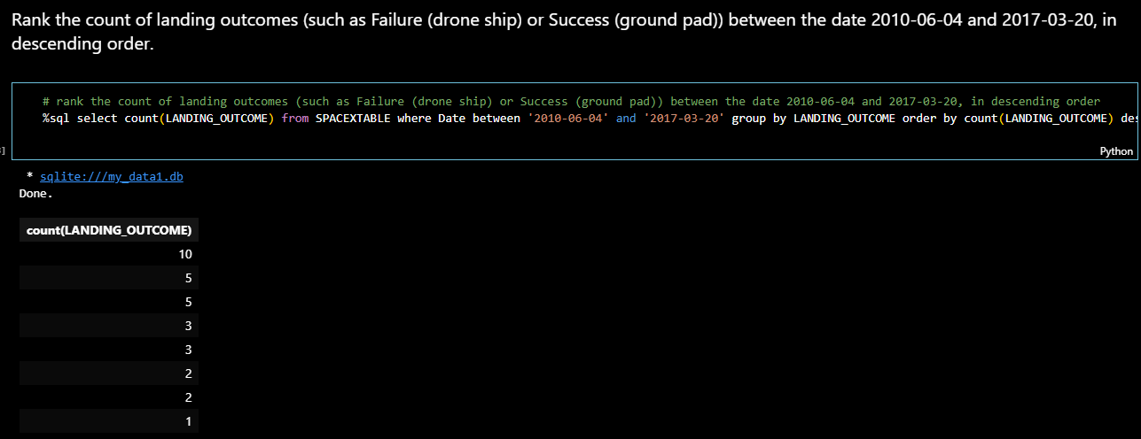
Rank Landing Outcomes Between 2010-06-04 and 2017-03-20
Rank the count of landing outcomes (such as Failure (drone ship) or Success (ground pad)) between the date 2010-06-04 and 2017-03-20, in descending order

Slide 36

Section 3

Slide 37
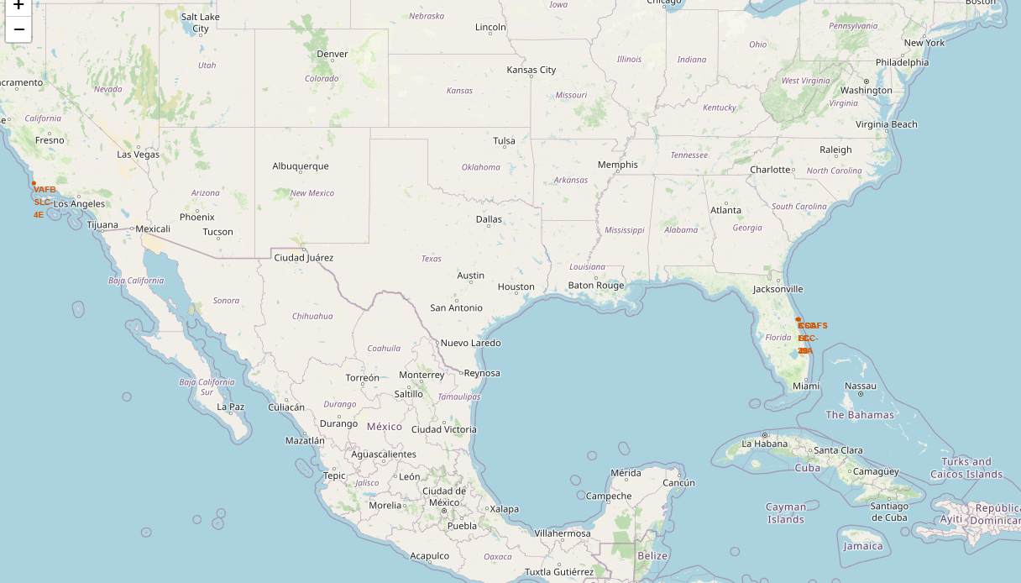
Launch Sites in U.S.
All launch sites’ location
Findings:
All locations are either in California or Florida
All launch sites are in coastal areas

Slide 38
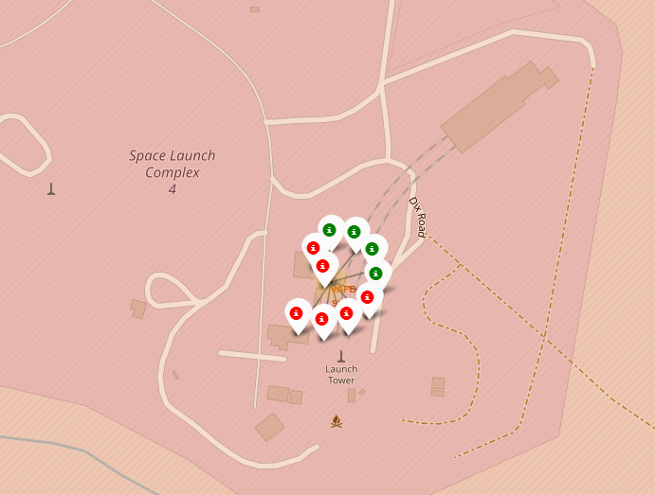
Coloured-Labelled Launch Sites
Findings:
Among the 10 launches at this site, 4 were successful while 6 failed.

Slide 39
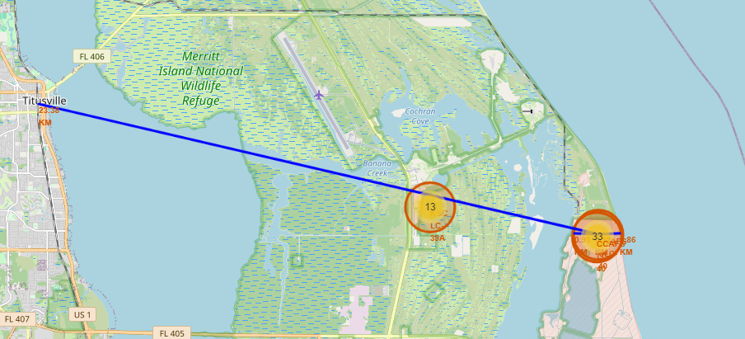
Distance to railway, highway and coastline
Findings:
The launch site is close to railway, highway and coastline, but far away from cities.

Slide 40

Section 4

Slide 41
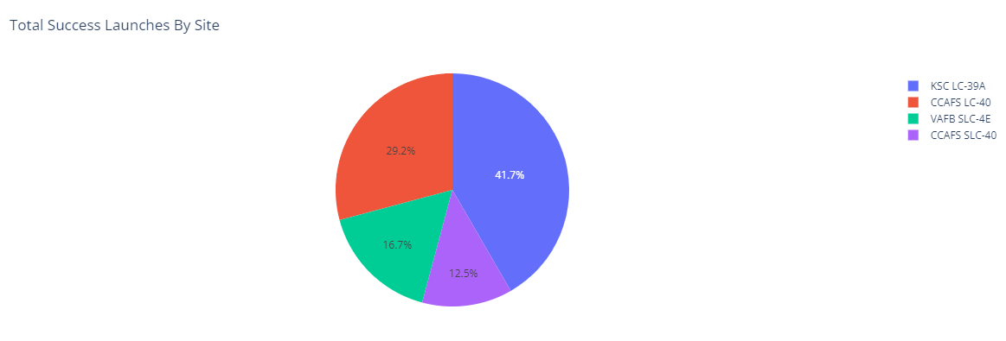
Launch Success
KSC LC-39A has the most successful launches

Slide 42
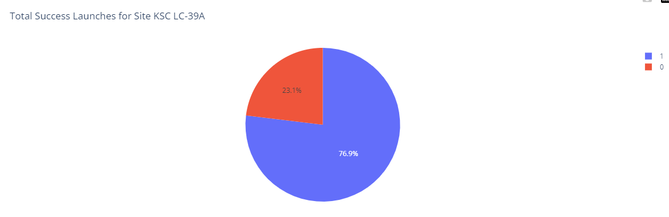
Launches records in KSC LC-39A
The success rates for the KSC LC-39A is 76.9%

Slide 43
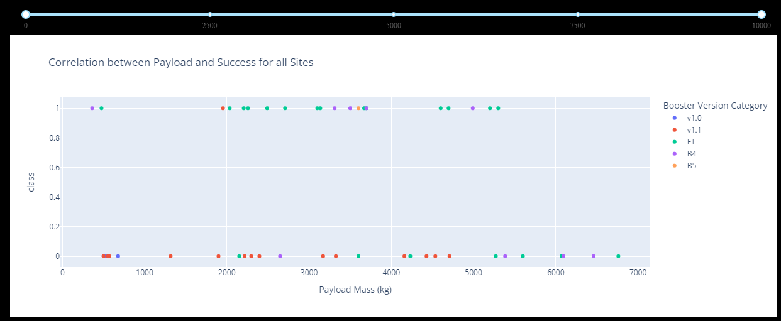
Launch records by boosters and payload
Findings: Booster version FT has the highest success rate.

Slide 44

Section 5

Slide 45
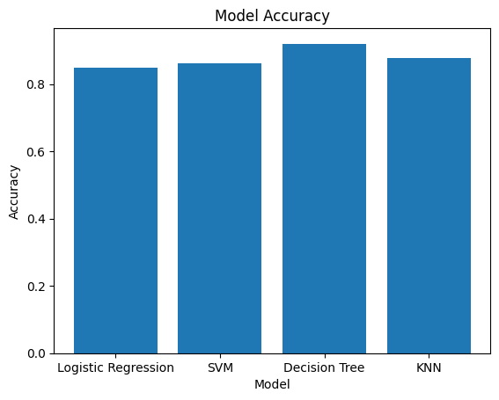
Classification Accuracy
The Decision Tree Model the highest classification accuracy

Slide 46
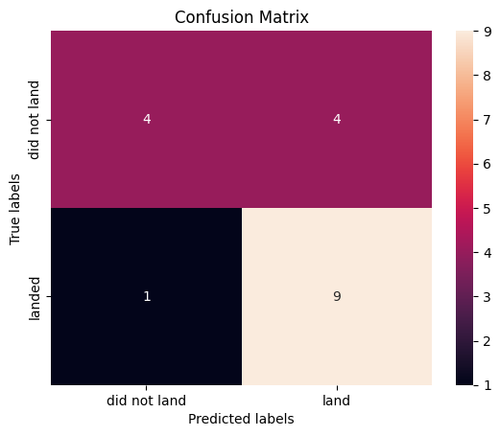
Confusion Matrix of Decision Tree Model
Top-left square (True Negative): The model predicted 4 instances of the class 'did not land' correctly.
Top-right square (False Positive): The model incorrectly predicted 4 instances as 'land' when they actually 'did not land’.
Bottom-left square (False Negative): The model incorrectly predicted 1 instance as 'did not land' when it actually 'landed’.
Bottom-right square (True Positive): The model predicted 9 instances of the class 'land' correctly.

Slide 47
Conclusions
Control the payload to a moderate size for higher success rate
Use the FT booster for a higher success rate
Launch in the site KSC LC-39A

Slide 48
Appendix
Notebook outputs/data sets
https://github.com/haoyileslie/Coursera/blob/main/dataset_part_1.csv
https://github.com/haoyileslie/Coursera/blob/main/dataset_part_2.csv
https://github.com/haoyileslie/Coursera/blob/main/dataset_part_3.csv
https://github.com/haoyileslie/Coursera/blob/main/spacex_web_scraped2.csv

Slide 49
Confusion Matrix
From the confusion matrix, we can calculate various performance metrics, such as accuracy, precision, recall, and F1 score, which provide more details on the model's predictive performance
Accuracy: (True Positives + True Negatives) / Total Predictions
Precision: True Positives / (True Positives + False Positives)
Recall (Sensitivity or True Positive Rate): True Positives / (True Positives + False Negatives)
F1 Score: Harmonic Mean of Precision and Recall

Slide 50


